Slide 1

Breakfastclub How Personality Traits effect attention and happiness in a simulated classroom
by Manuel Pasieka
Master en Inteligencia Artificial
Universidad Internacional de La Rioja

Slide 2
Content
Introduction
Objectives
State of the Art
Proposed solution and Implementation
Results and Conclusion
Questions
2

Slide 3
Introduction
How different personalities effect classroom attention and happiness?
3

Slide 4
Introduction
How different personalities effect classroom attention and happiness?
Build a Simulation of a virtual classroom and study different personality profiles.
4

Slide 5
Objetivos
General Objetives
Develop a multi agent based simulation of a virtual classroom
Base Agent behavior on personality trait model
Study different personality profiles
Particular Objetives
Develop a deterministic closed loop simulation using Unity3d
The simulation software and the specific simulation should be configurable
5

Slide 6
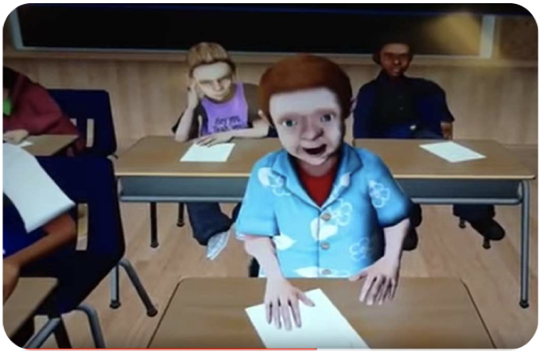
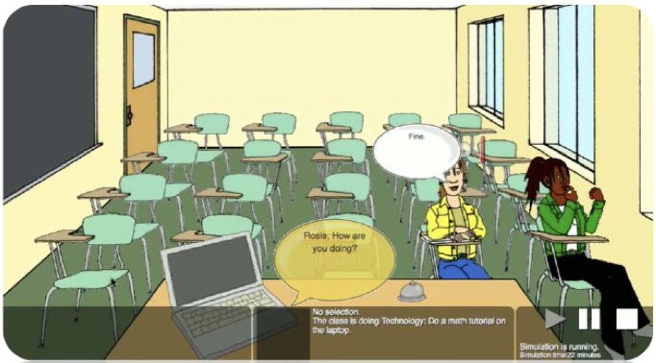
State of the Art
Commercial software exists that fails to be
Open Source
Agent based models
Flexible
Reproducible
Data Analysis
Teach Live
SimSchool

Slide 7
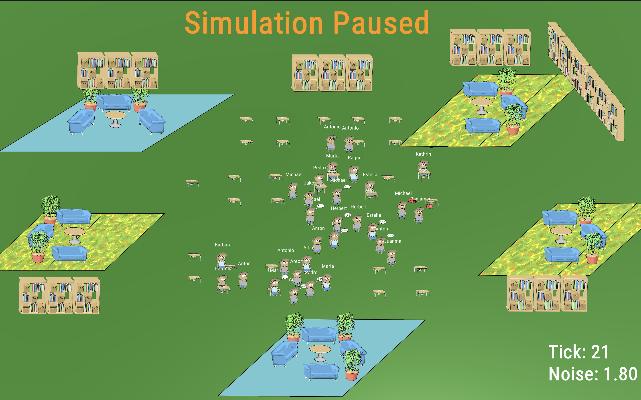
Breakfastclub
Unity3d based deterministic closed loop simulation
Base Agent behavior is based on the big five personality model
Simulation and Analysis are automatized

Slide 8
Breakfastclub
Agent based Models
Big Five Personality Model
Simulation: Agent, Logic, Analysis

Slide 9
Agent based models
Agent based model
An agent-based model (ABM) is a class of computational models for simulating the actions and interactions of autonomous agents (both individual or collective entities such as organizations or groups) with a view to assessing their effects on the system as a whole.
- Wikipedia
Applied in various fields
Biology (e.g. epidemics)
Economics (e.g. Stock Trade)
Social Studies (e.g. Social Networks)

Slide 10
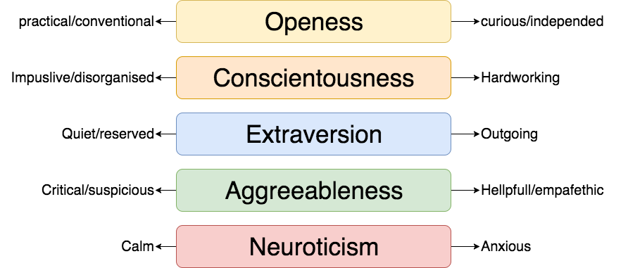
Big Five Personality Model
OCEAN or Big Five is a widely used empirical model, applied in theoretical and practical settings[1].
[1] Norman, W. T. (1963). Toward an adequate taxonomy of personality attributes. Journal of Abnormal and Social Psychology, 66(6), 574–583. https://doi.org/10.1037/h0040291

Slide 11
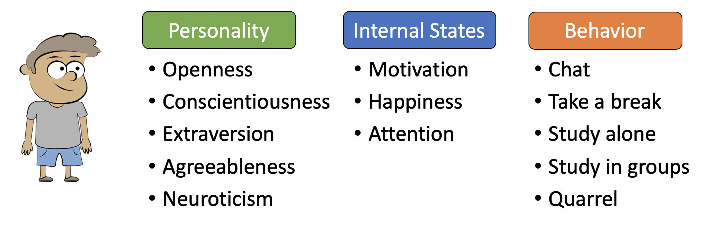
Agents

Slide 12
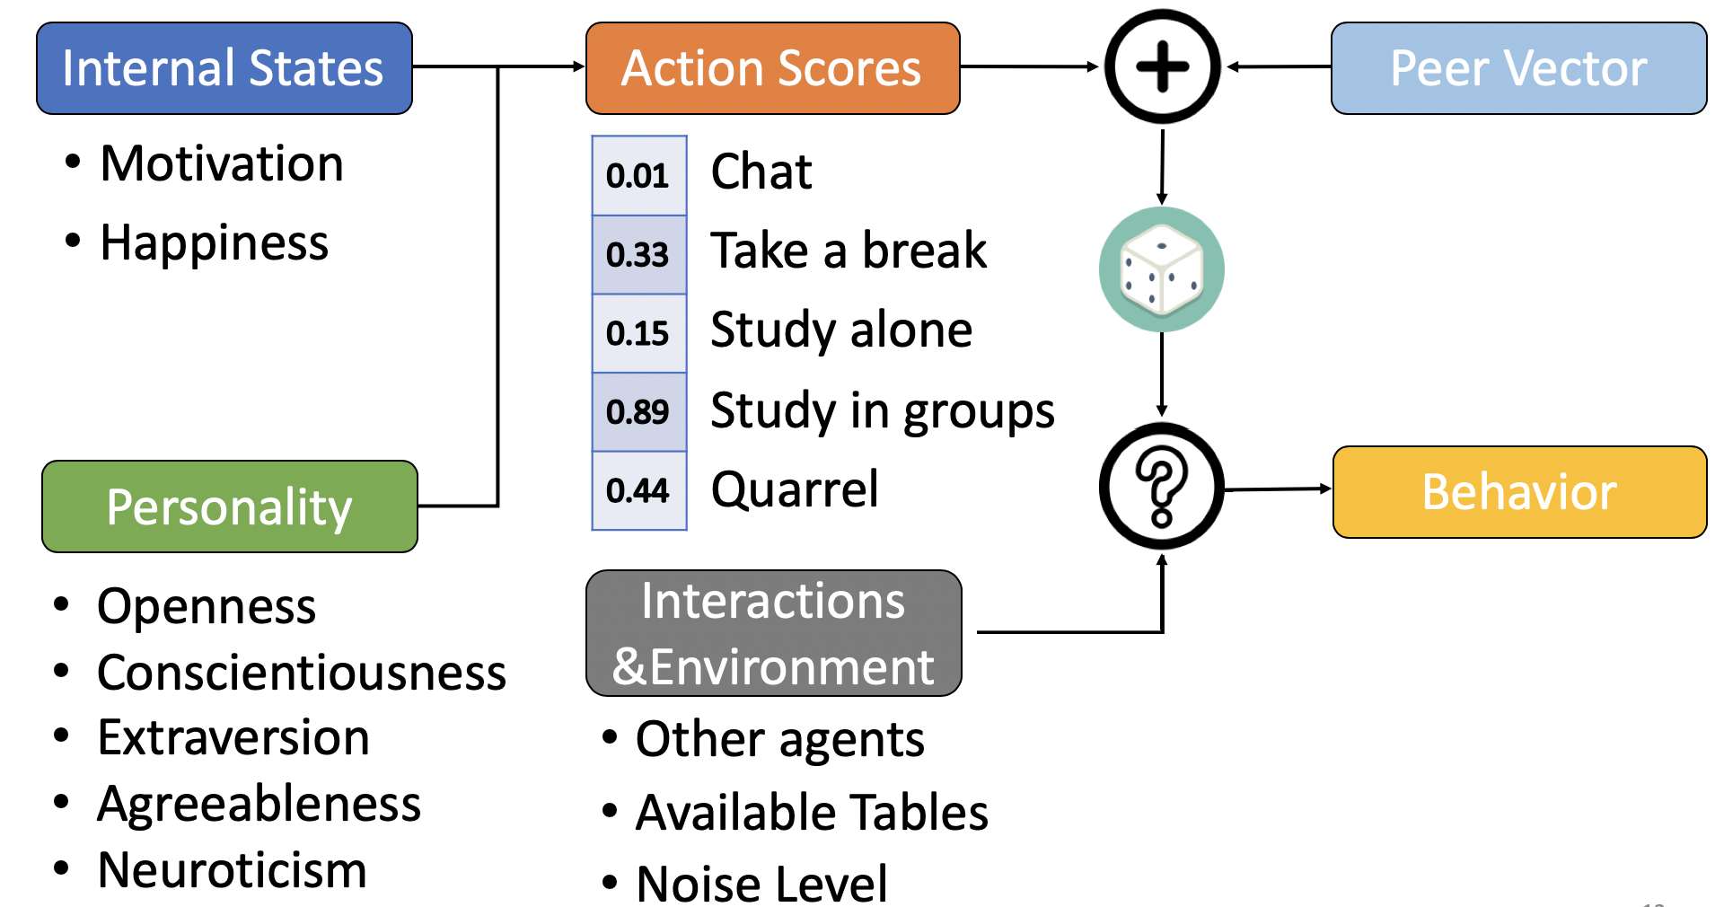
Agent Logic

Slide 13
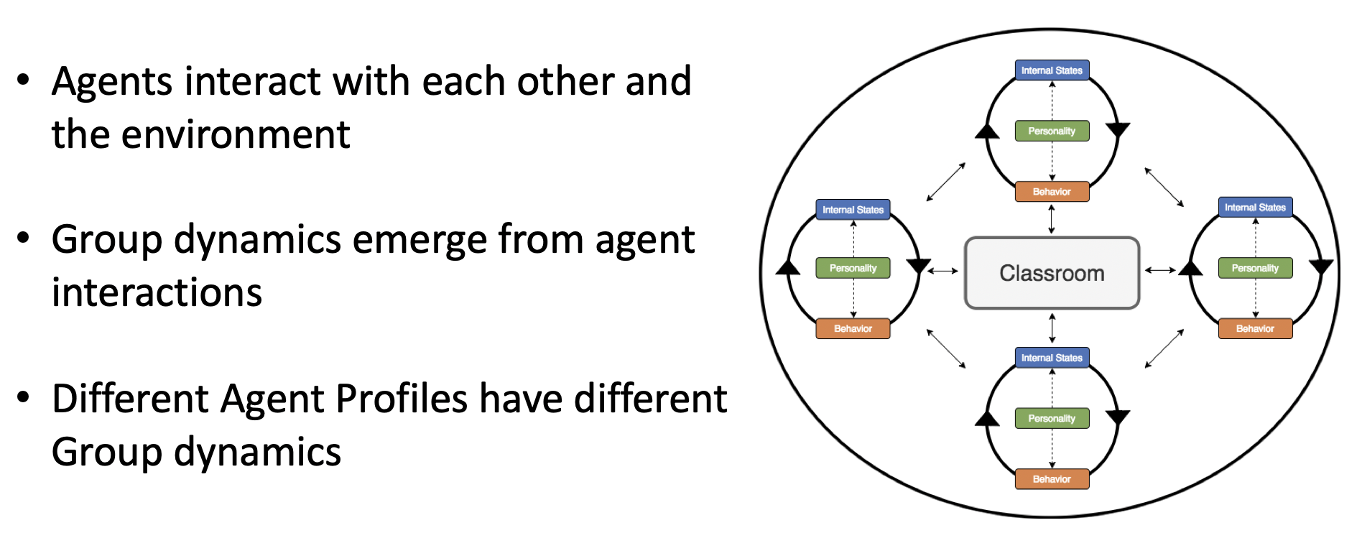
Agent and Group Dynamics

Slide 14
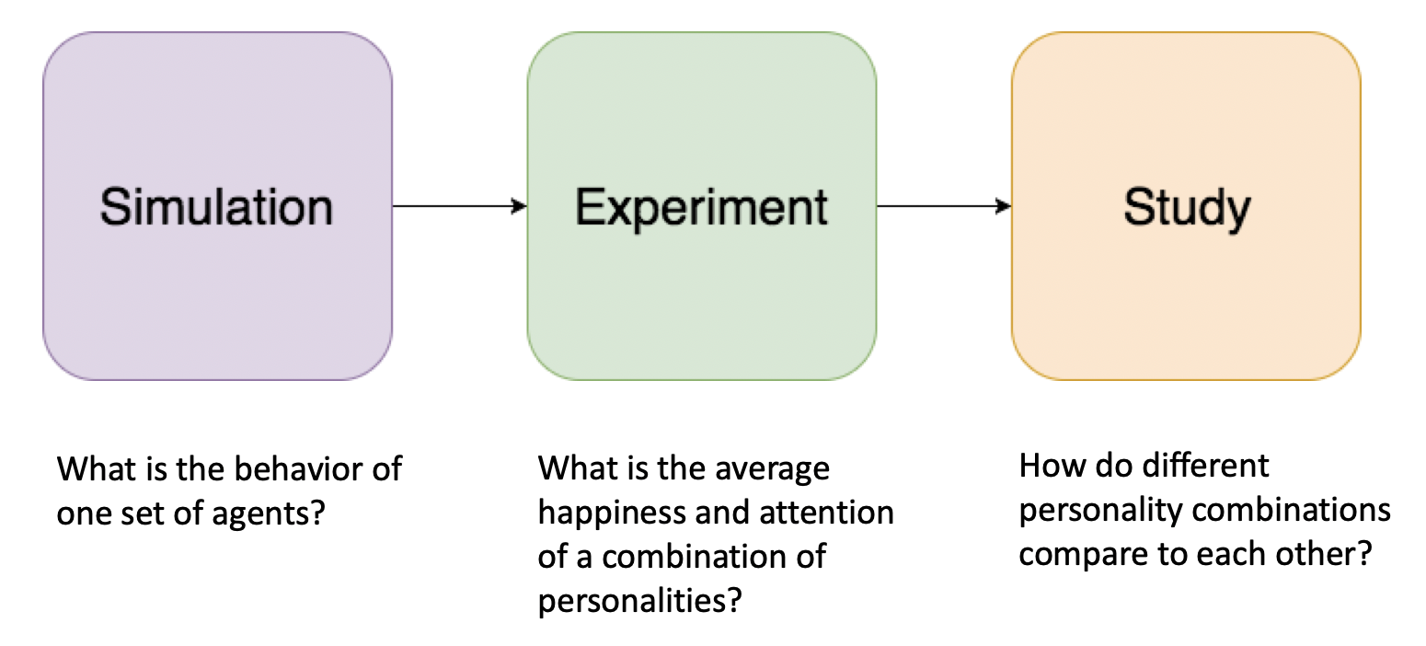
Execution and Data Analysis

Slide 15
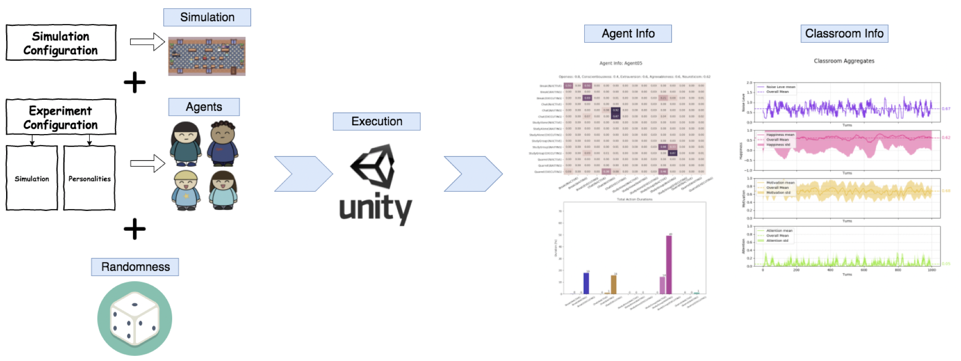
Execution and Data Analysis

Slide 16
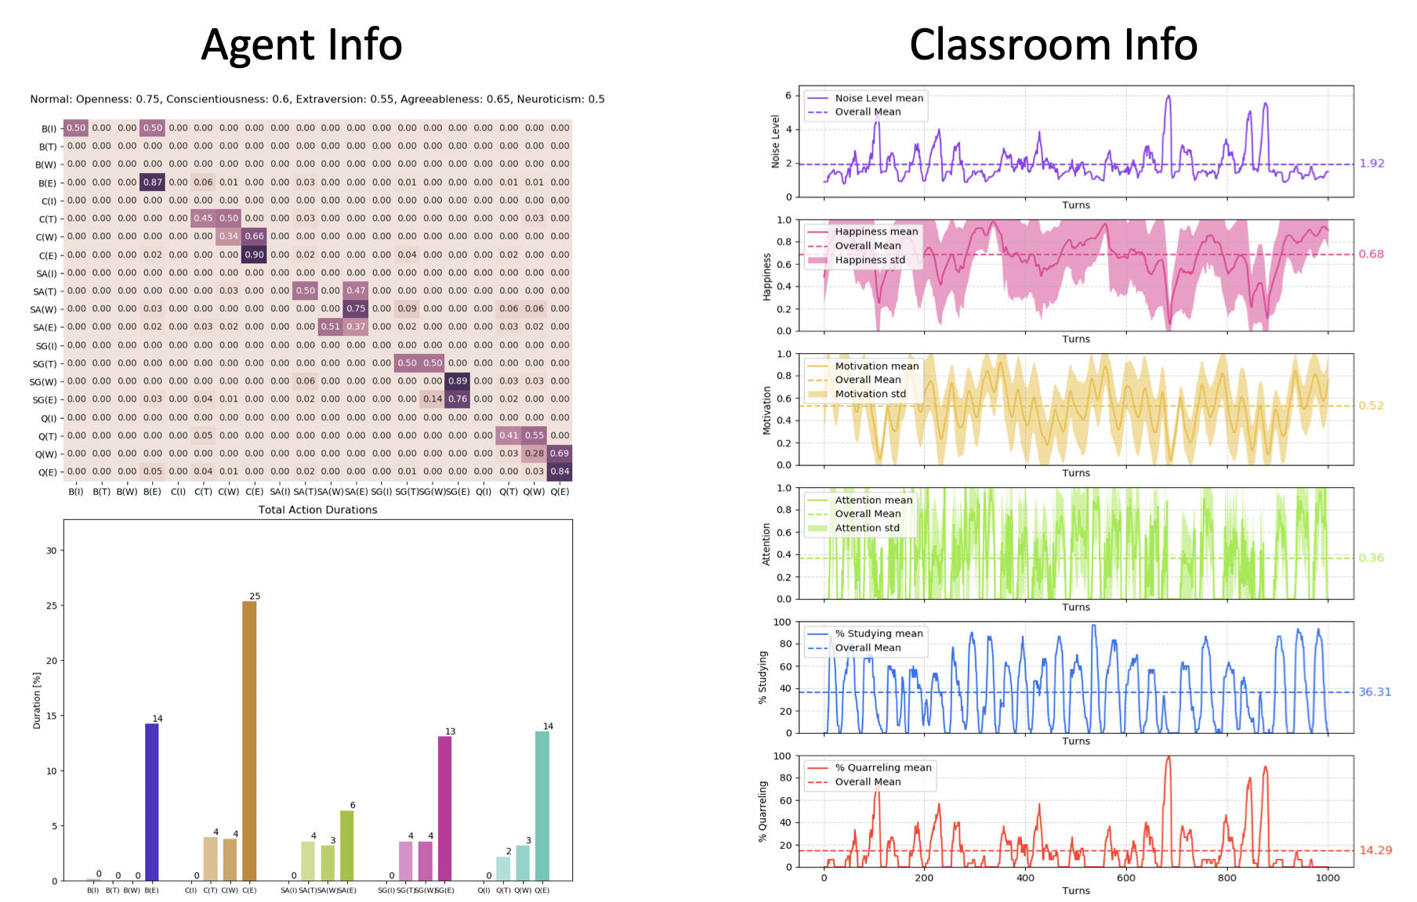

Slide 17
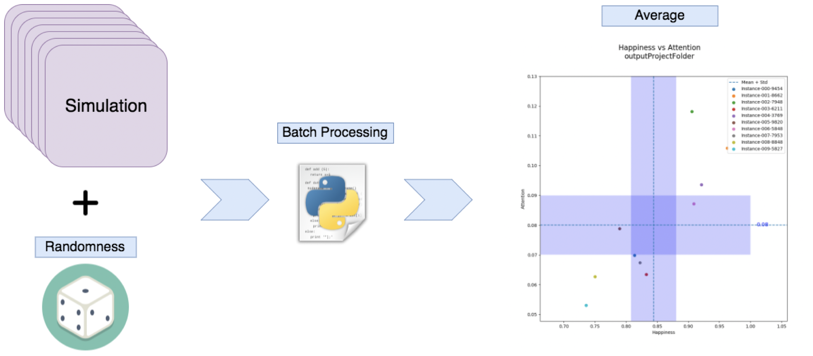
Execution and Data Analysis

Slide 18
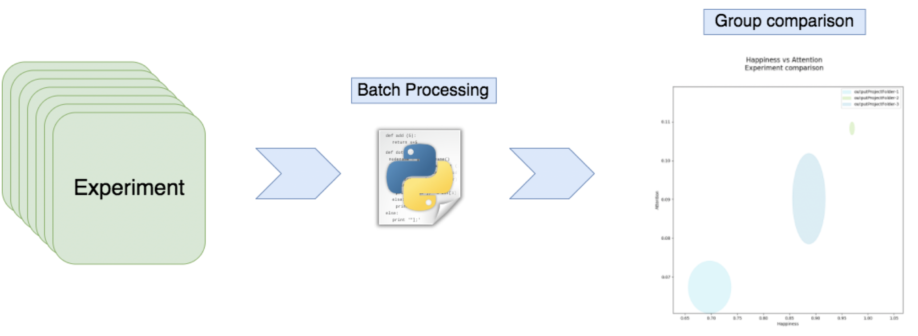
Execution and Data Analysis

Slide 19
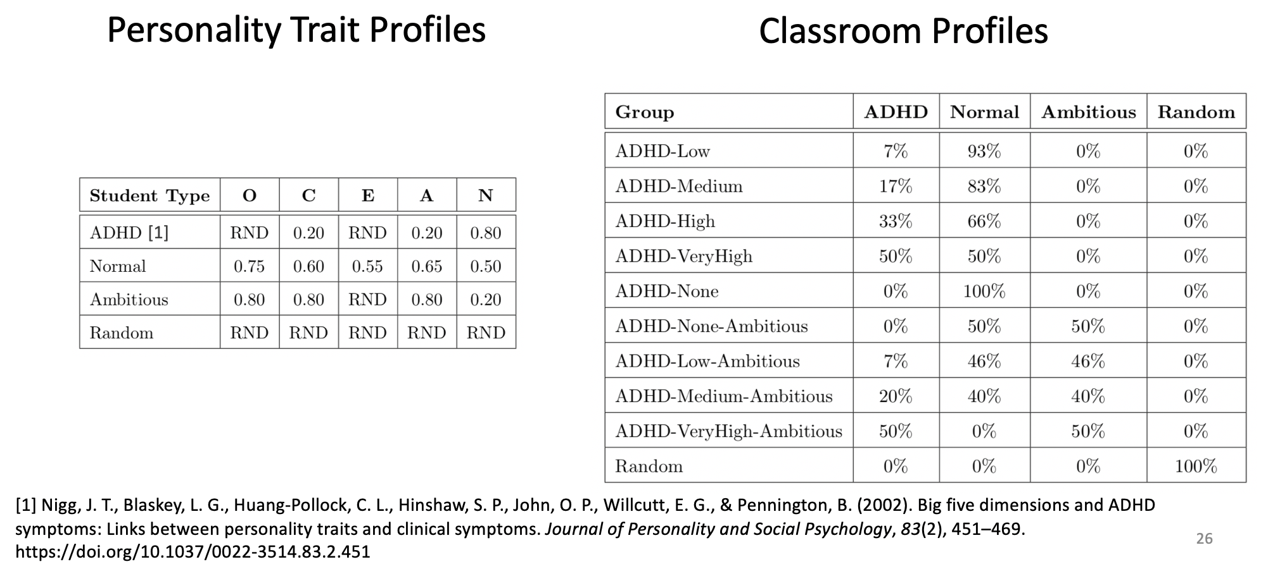
Experiment and Study

Slide 20
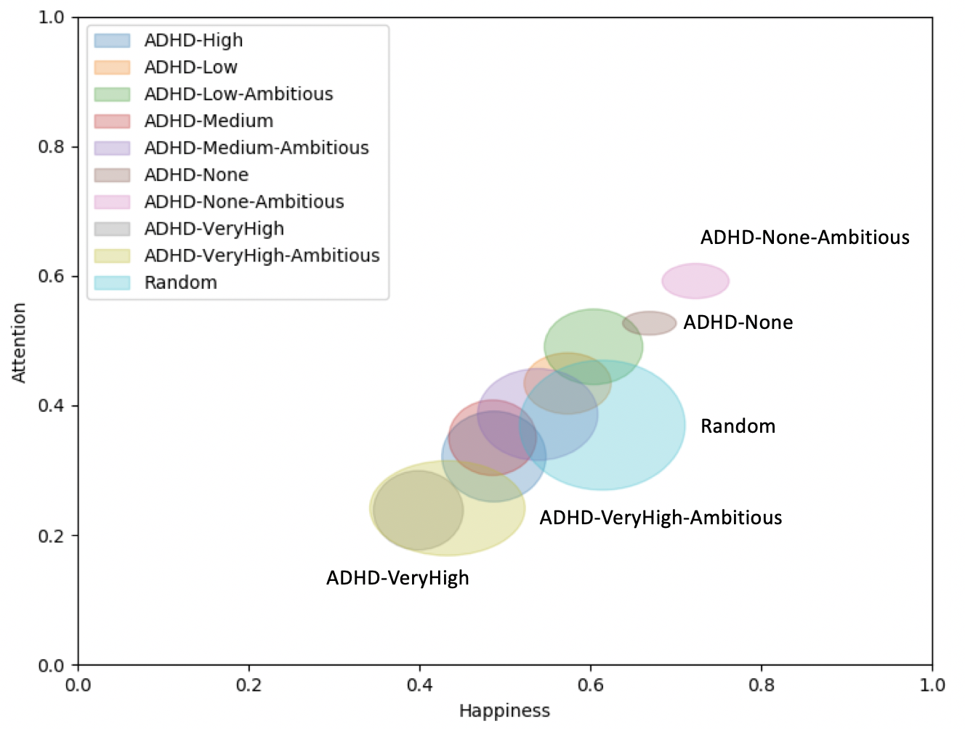
Results

Slide 21
Conclusion
Open Source Simulation https://github.com/mapa17/breakfastclub
Consistent group difference between personality profiles

Slide 22
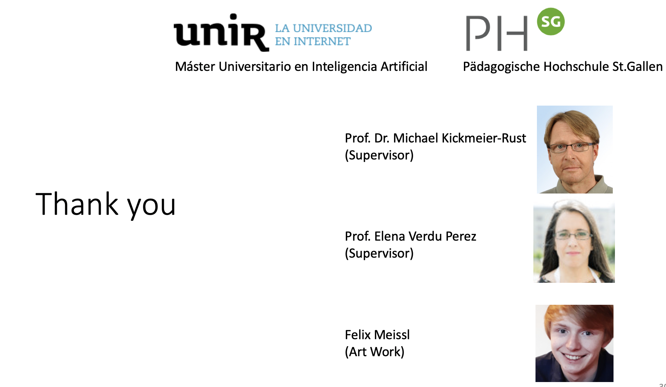

Slide 23
Quistiones
23

Slide 24

www.unir.net

